Slide 1
The art of the cold call
Building your toolbox to recruit members & organizing Granges
© National Grange 2016

Slide 2
What is cold calling?
    “A telephone call [or visit] soliciting business made directly to a potential customer without prior contact or without a lead” ~Merriam-Webster
Who do we cold call?
  Decision makers, communicators, leaders
Where do we cold call?
  Door to door or “mass marketing” (farmers markets, festivals, etc.)

Slide 3
Scouting
Identify a community/area/group to work
Stand alone community or group of towns
Get to know the community
  What activities are there
  Are there other community/civic/fraternal organizations
  What challenges is this area facing
  Is business active

Slide 4
Preparation
Make a short and long term game plan
  Short term: Who will you contact, how will you promote, etc.
  Long term: informational/organization meeting date, activities to utilize, etc.
Find people & businesses you want to work with
Make a list of contacts
  People you do and don’t know

Slide 5
Who Do you Want to Talk to?
Extension Agents
FFA Advisors
Farm Bureau Leaders
Chamber of Commerce Leadership
Commodity/Producer organization leaders
Local Newspapers
Local Radio
Decision makers & those who have contacts

Slide 6
Initial Contact
Structure your ‘call’ sheet
  Don’t eat the elephant in one sitting
Know the “product” you’re selling and how it applies to your “customer”
  Know it and believe in it
Deliver your pitch concisely
  Have a plan or script
  Know your options
  Focus on the benefit to them
  Don’t be afraid to ask them for more info
Notes:
This isn’t always calling on the phone

Slide 7
‘No’ mean Go
Someone saying no isn’t a rejection
Chance to use your personality
Share your Grange story
Be ready to hear no
Know their objections
  Fear of the new?
  Time commitment?
  Not entirely sold?

Slide 8
Building Your “Toolbox”
Start with the basics (What we are general terms)
    Community-based, fraternal organization
    National Grange mission statement
Expand
  We are a place for the family to come together
  Leader on advocating for American values & hometown roots at the community, state & national level.
  Traditions & history
Fill with all the tools (Features/Programs)
  Programs
  Social Benefits
  Personal Benefits
Notes:
Don’t just tell them what programs/benefits/services there are
Tell them how they apply to the buyer

Slide 9
Use Your Tools
With your “toolbox” build your sales pitch
Know who you’re selling to
  What are their concerns?
  What are their interests?
  How can we best serve them?
Selling is the art of serving the “buyer”
Notes:
Create a sense of urgency. When selling tangible products, this is done though different devices (join now and save $50; free item to those who join in this month)
In Grange we can do this by having relevant projects & activities that are the “incentives” to join
ACTIVITY: Build your toolbox. Start by writing the parts, then put the whole pitch together.
Be sure not to just say we have a youth/junior/legislative program. Say how it benefits them!

Slide 10
Follow Up
Keep good records
Ask for an email or mailing address
Send a follow up letter or email thanking them for the conversation and with Grange information
After initial contact you should have interest for your next round of “warm calls”

Slide 11
Tips & Best Practices
Be upfront
Answer “objections” honestly
Make it easy to join!
Make every recruiting effort personal
Establish a regular, measurable recruiting program
Learn from your experiences

Slide 12
The Informational Meeting
Can set the date before you have commitments or after
Advertise it!
If you have contacts, send an invite (or reminder)
Have a short presentation
Have applications & brochures ready
Notes:
Advertise: local dailys & weeklys, regional dailys & weeklys, Radio; send a press release
Find out from the locals what’s best

Slide 13
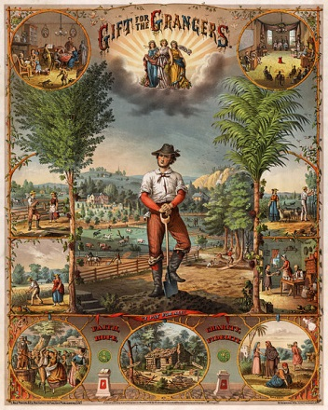
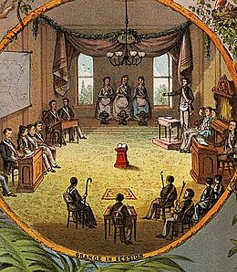
Final Thoughts
Let it be a lesson, never to be forgotten, that success in a good cause is gained only by perseverance. Never be discouraged.

Slide 14
Presentation prepared by:
Joseph B. Stefenoni
Former National Grange Membership/Leadership Development Director
National Grange
1616 H Street NW
Washington, D.C. 20006-4999
888-4-GRANGE/707-328-0631
membership@nationalgrange.org

Slide 15
The art of the cold call
Recruiting members & organizing Granges
© National Grange 2016

