Slide 1

REBUILD RURAL:
National Grange Virtual Fly-In
April 7, 2021

Slide 2
Background on Rebuild Rural
Started in February of 2017
Now more than 260 organizations from across the country
Advocating for investment in infrastructure that recognizes rural America’s needs are fundamentally unique
Infrastructure improvements are needed for U.S. to maintain status as the global leader in agriculture & to support the prosperity of rural communities

Slide 3








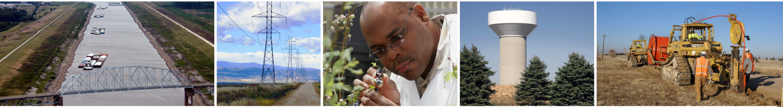
Coalition Priorities Areas

Slide 4
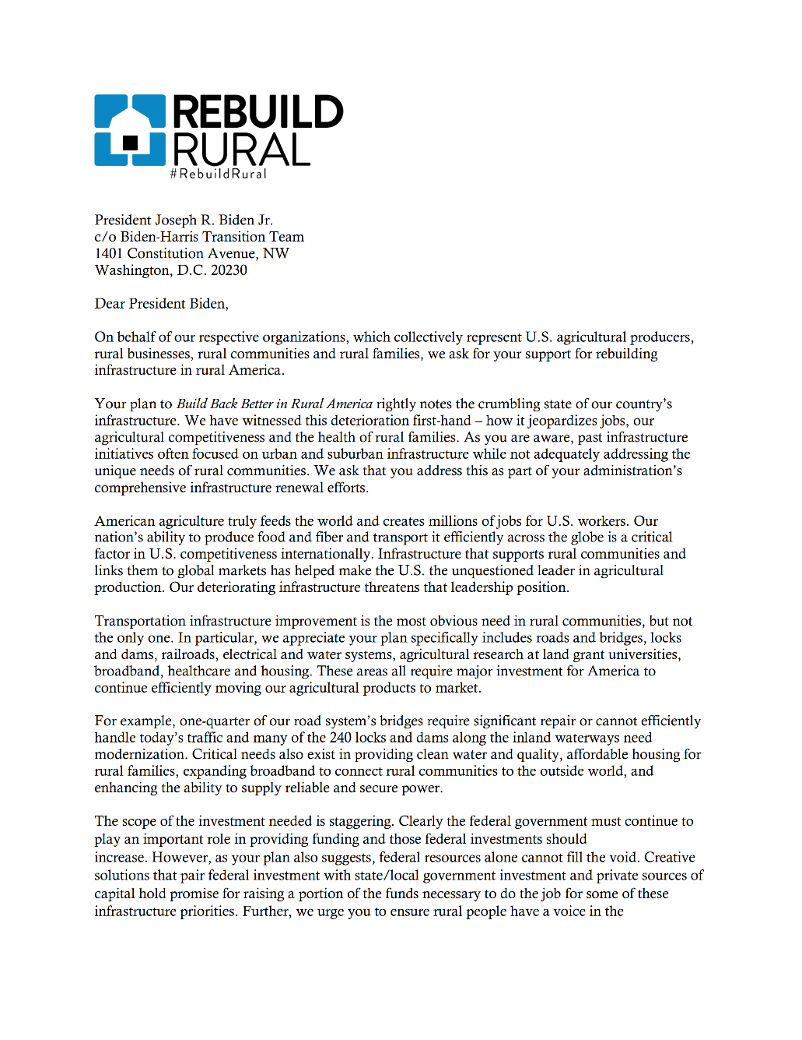
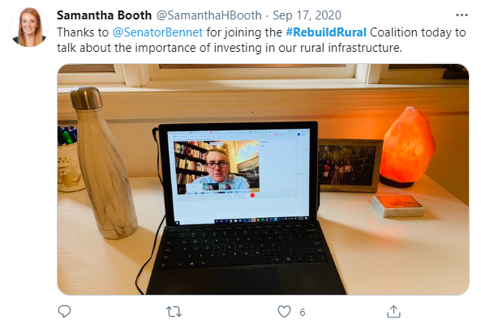
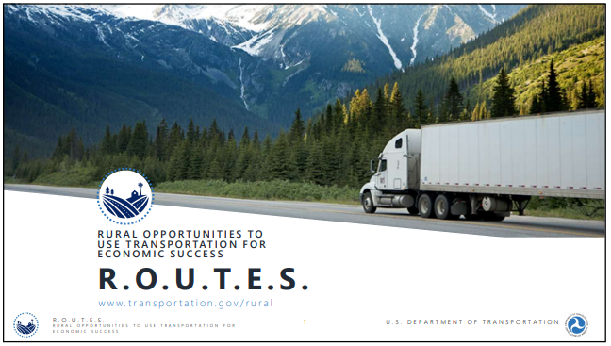
Rebuild Rural Engagement-
With Policy Makers
Coalition Meeting with Sen. Bennet
DoT Webinar for Rebuild Rural
Letter to President Biden

Slide 5
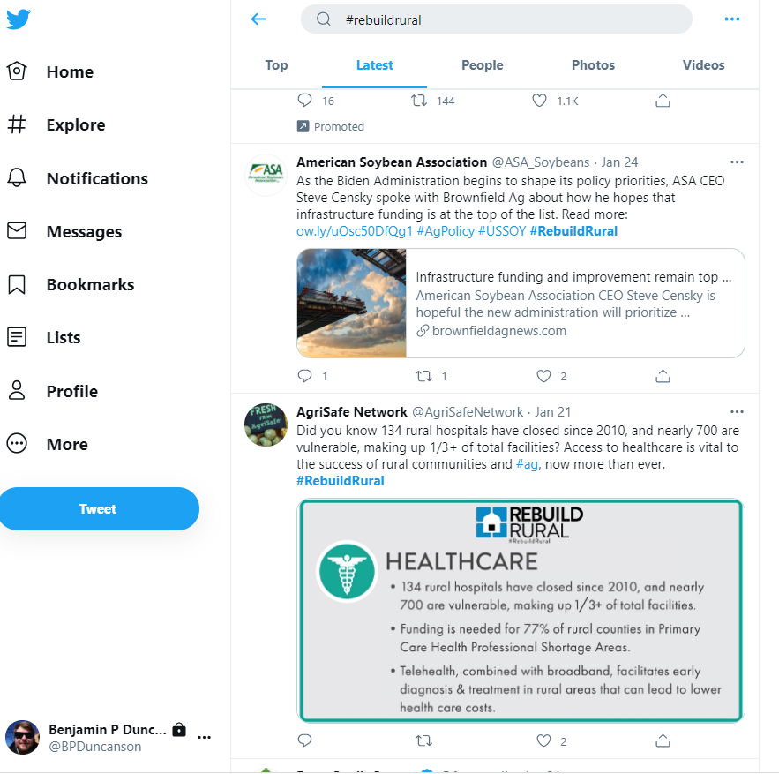
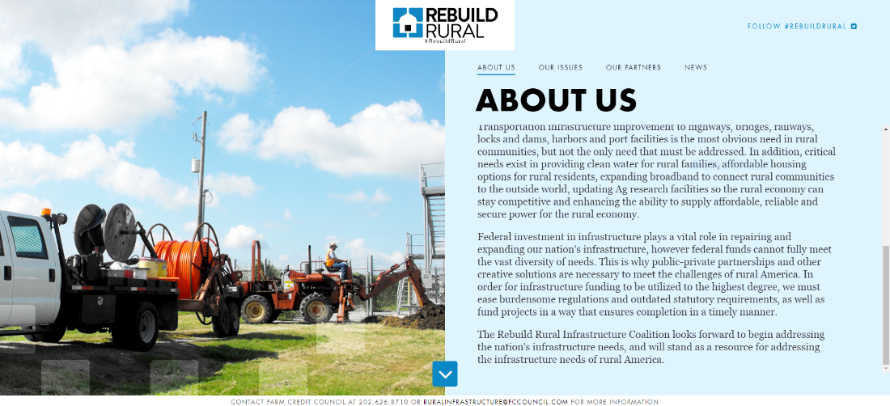
Rebuild Rural Engagement –
Communications
On-Going Social Media Champagne
Coalition Website
More Information at RebuildRural.com
Join us by using #RebuildRural

Slide 6
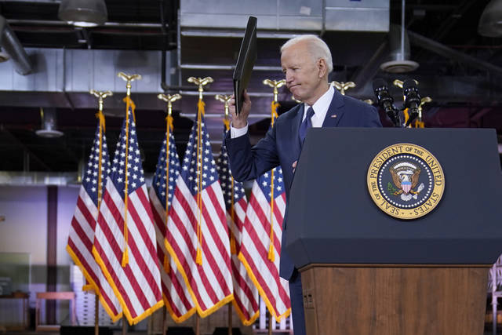

What’s Next for Rural Infrastructure?
The American Jobs Plan:
First of a two proposals that the Biden Administration will unveil, with the second coming out next month focused more on “human infrastructure”
It proposes $2 trillion over the next ~8 years and full paid for over the next 15 years.
Possible pay-for include raising the corporate tax to 28% and other repeals of the “Tax Cuts and Jobs Act”
From the talking points:
Fix highways; rebuild bridges; and upgrade ports, airports, and transit centers.
Rebuild clean drinking water infrastructure, a renewed electric grid, and high-speed broadband to all Americans.
Modernize homes, commercial buildings, schools and federal buildings.
Create caregiving jobs and raise wages and benefits for essential home care workers.
Revitalize manufacturing, ensure products are made in America and invest in innovation.
Create good-paying union jobs and train Americans for jobs of the future

Slide 7
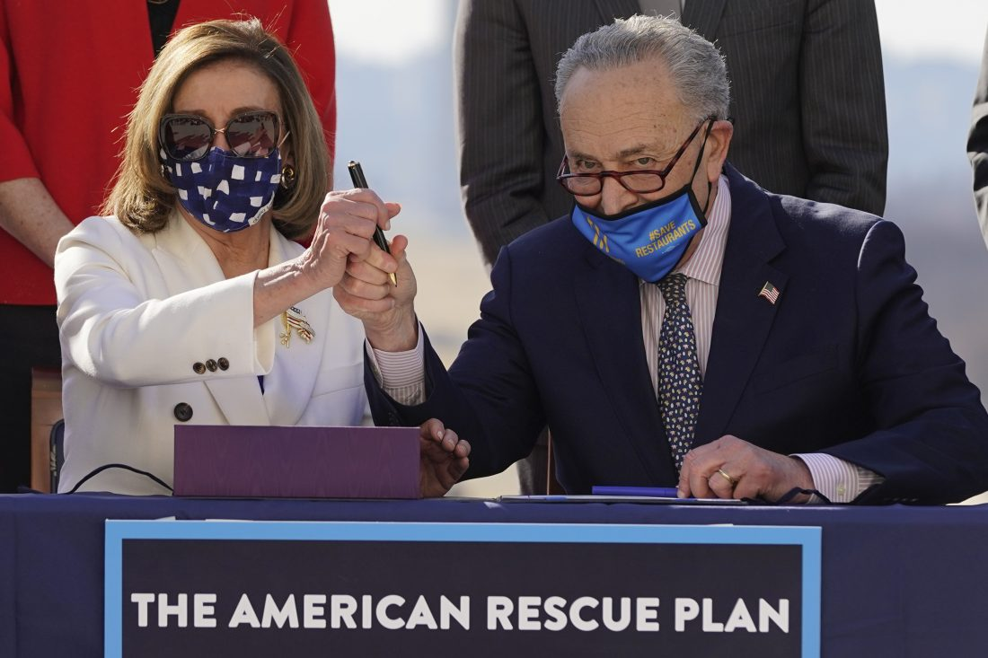
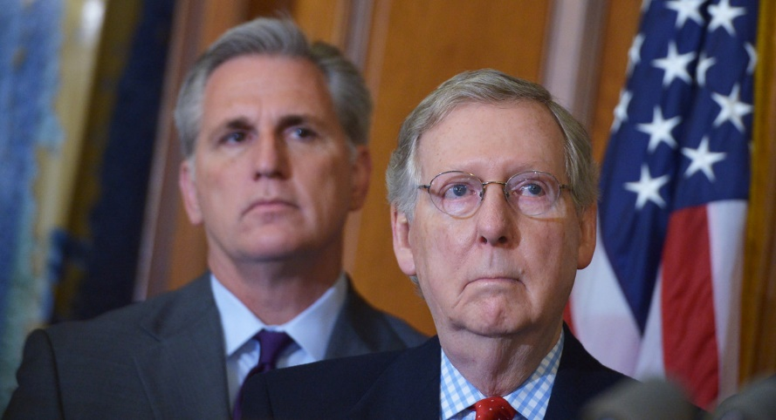
What’s Next for Rural Infrastructure?
On to Congress:
Proposed as a bipartisan measure
Congress will be drafting over the coming months
Timing still unclear, largely depends on what compromises they can find... or not
Things to remember:
Democrats still have at least one budget reconciliation left to use
This is part 1 of 2
Earmarks 2.0!
Climate change measures will play a big part in this legislation
Transportation bill reauthorization by September
Which is continued to be worked on independent of this.
Needless to say, more “infrastructure weeks” to come in 2021…

Slide 8
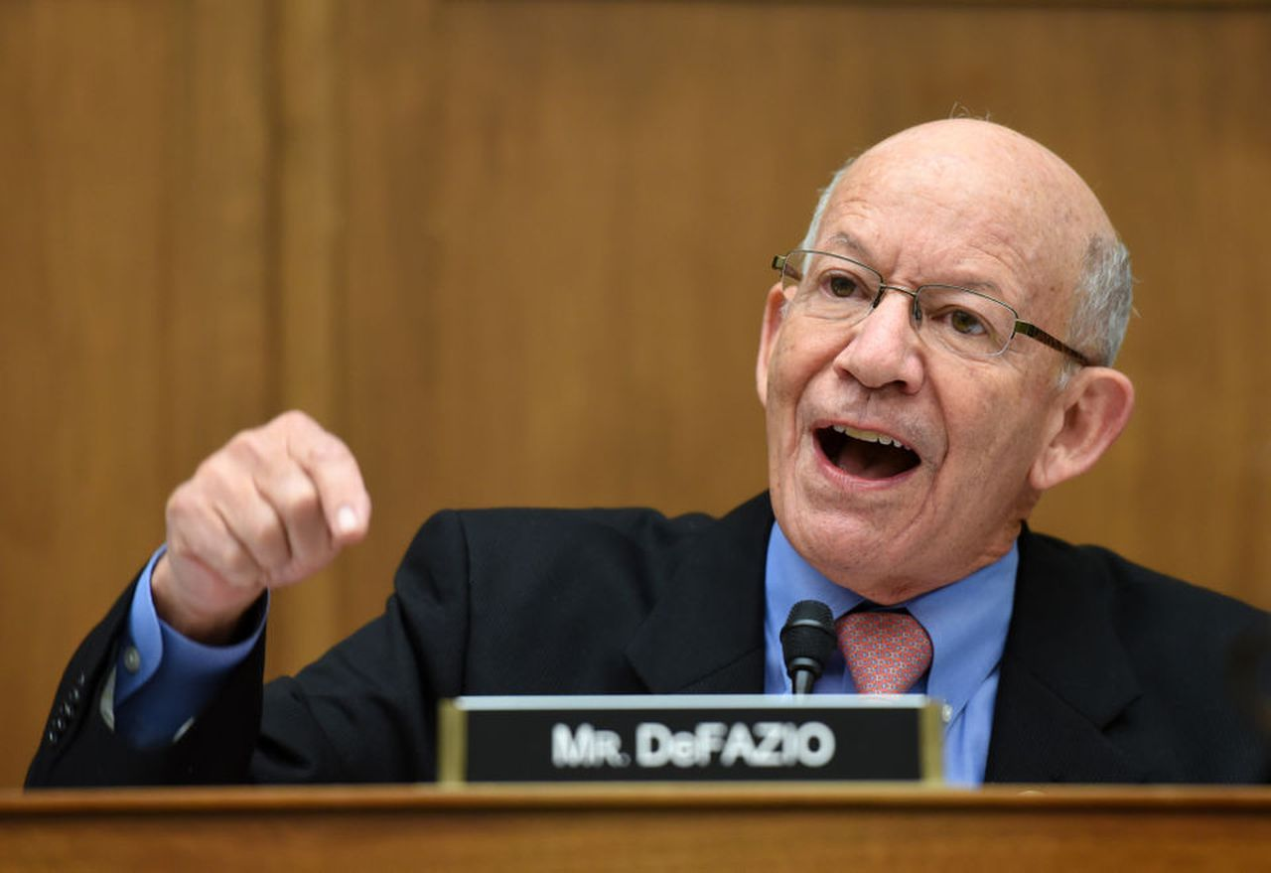
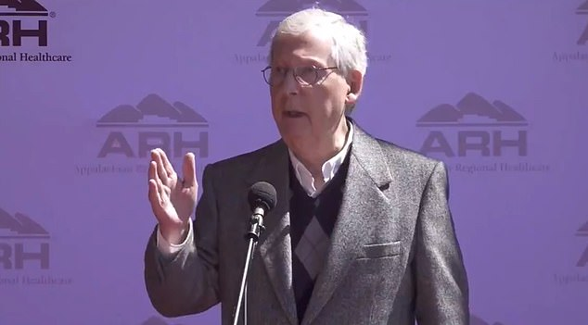
What’s Next for Rural Infrastructure?
“President Biden’s American Jobs Plan is visionary and exactly what people across this country have been asking for from national leaders for years, even decades. The plan the president laid out today makes the kind of investments that I believe we should be making to move our infrastructure out of the 1950s and into the modern era.” Peter Defazio (T&I Committee Chair)
"That package that they're putting together now, as much as we would like to address infrastructure, is not going to get support from our side. Because I think the last thing the economy needs right now is a big, whopping tax increase," Mitch McConnell
“This is not nearly enough.” Alexandria Ocasio-Cortez

Slide 9

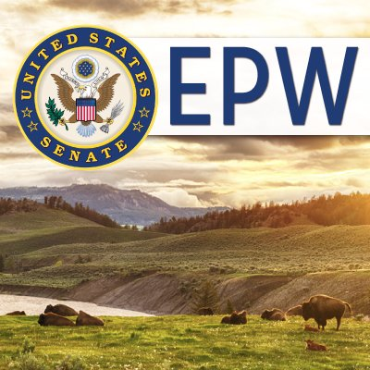
Big Infrastructure Package on the Hill
As many as 15 committees could have jurisdiction of over sections of any possible infrastructure proposal including but not limited to:
Senate:
Agriculture
Appropriations
Banking Housing & Urban Affairs
Budget
Commerce, Science & Transportation
Energy & Natural Resources
Environment & Public Works
Finance
House:
Agriculture
Appropriations
Budget
Energy & Commerce
Financial Services
Natural Resources
Transportation & Infrastructure
Ways & Means

Slide 10
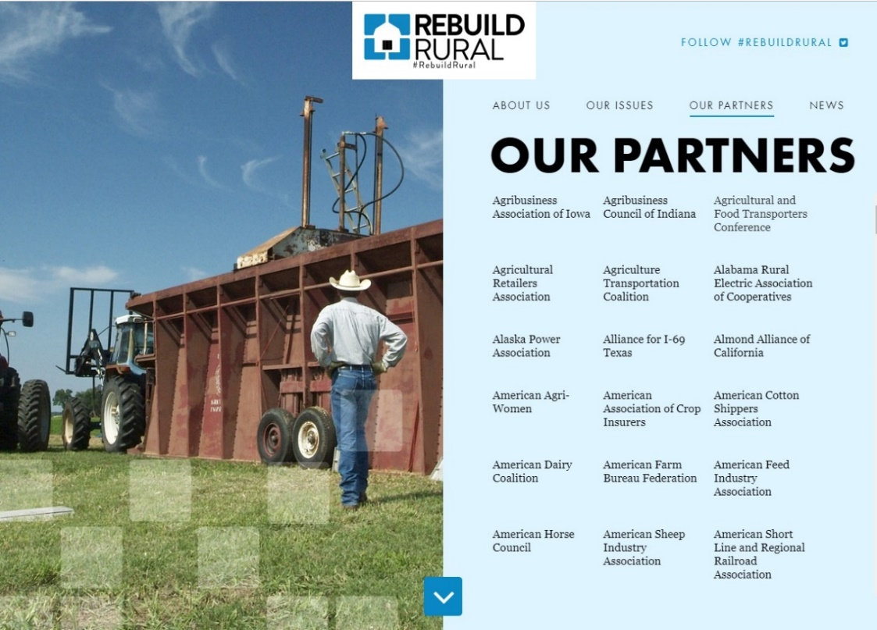
Thank You!
Robbie Boone
Farm Credit Council
(202) 879-0855
boone@fccouncil.com
RebuildRural.com

Slide 11
Net Cash Income Increase for 2021
2007-2021F Ave = $109.2 Billion
Source: USDA-ERS data (Feb. 2020)
11

Slide 12
Net Cash Income Increase for 2021
2007-2021F Ave = $109.2 Billion
12
Source: USDA-ERS data (Feb. 2020)

Slide 13
Farm Balance Sheet Leverage Increases
Farm sector debt-to-asset ratio
Source: USDA-ERS data (Feb. 2020)

Slide 14
Farm Balance Sheet Leverage Increases
Source: USDA-ERS data (Feb. 2020)

Slide 15
Working Capital Lags Income
Farms’ Working Capital vs Net Farm Income
Source: USDA-ERS Data (Feb. 2020)

